Slide 1


12th International Young Scientists Conference on Computational Science
Adaptive Fusion and Transfer Learning for Enhanced E–Commerce Recommendations
Vibhav Baggaª, Sushanth Sugunanª, Apoorva Srivastavaª, Rajeev Kumarª, Prof. Anshul Guptaª, Dhananjay Kumar^{b}, Dr Debashis Guhaª
ª S P Jain School Of Global Management, Dubai, UAE ,^{b} Charismatic Attic Partners, New Delhi, India

Slide 2


Table of Contents
Introduction
Literature Survey
Problem Statement
Methodology Adopted
Results Obtained
Conclusion & Future work
References

Slide 3
Introduction
Adaptive Fusion and Transfer Learning for Enhanced E–Commerce Recommendations (AFETLER)
Need:
Challenges in E-commerce Recommendations: Existing recommendation systems face limitations in adaptability and relevance, particularly with the "cold start" problem for new items and changing user behaviors.
The Need for Innovation: Conventional models struggle to provide real-time, personalized recommendations, necessitating a comprehensive solution for enhancing user experience and increasing platform revenue.
Introduction to AFETLER:
Holistic Approach: AFETLER combines state-of-the-art recommendation frameworks, addressing diversity, serendipity, and the cold start problem.
Innovative Techniques:
Adaptive Fusion: Dynamically combines recommendations from various sources, optimizing accuracy through context-aware suggestions.
Transfer Learning: Utilizes knowledge from existing items to enhance recommendations for new items, overcoming the cold start challenge.
Hierarchical Attention Mechanisms: Captures intricate user-item interaction patterns, elevating recommendation quality.
1

Slide 4
Literature Survey
Seminal papers and problem areas that inspired development of this holistic recommendation approach
ATNN: Adversarial Two-Tower Neural Network for New Item’s Popularity Prediction in E-commerce – Paper
Cold Start problem
Click Through rates
Generative Adversarial networks
Sparse data
A Model of Two Tales: Dual Transfer Learning Framework for Improved Long-tail Item Recommendation - Paper
Transfer learning
Skewed real world recommendation dataset
Deep Neural Networks for YouTube Recommendations – Paper
Deep Learning
Scalability
Freshness in recommendation
2

Slide 5
Literature Survey
Seminal papers and problem areas that inspired development of this holistic recommendation approach
4. A Dual Augmented Two-tower Model for Online Large-scale Recommendation – Paper
Scalable retrieval
Category alignment loss
5. Personalized Embedding-based e-Commerce Recommendations at eBay - Paper
Cold Start
Implicit Feedbacks
6. Zero Shot on the Cold-Start Problem: Model-Agnostic Interest Learning for Recommender Systems – Paper
Cold Start
Embeddings and feature space
Ranking
Key Takeaways:
Bridging gaps in existing models for new item prediction and long-tail recommendation.
Advancements in deep learning techniques for more accurate, efficient, and personalized recommendation systems.
3

Slide 6
Problem Statement
E-commerce challenge: Optimize recommendation systems for personalized, revenue-boosting suggestions.
Need for adaptability due to dynamic user behavior and market trends.
Solution Approach: AFETLER Model
Integration Components:
User-item interactions
Attention mechanisms
Transfer learning
Feedback loops
Objective:
Seamlessly integrate user preferences and item features.
Enhance user experience and maximize platform revenue through optimized item recommendations.
4

Slide 7
Problem Statement
Problem Definition:
Input:
User behaviour data (features, ratings)
Item data (attributes, categories, interactions)
Output:
Personalized and context-aware recommendations
Maximized platform revenue via high-conversion item recommendations
Intermediate Steps:
Two-Tower Neural Network (TNN)
Adaptive Fusion
Hierarchical Attention (MCAU – Multi Channel Attention Unit)
Transfer Learning
Alignment Loss Functions (ATL)
Feedback Loop
Sub-Objective:
Refine recommendation system iteratively based on feedback.
Improve user engagement, satisfaction, and platform revenue.
Overcome existing limitations in e-commerce recommendations
5

Slide 8
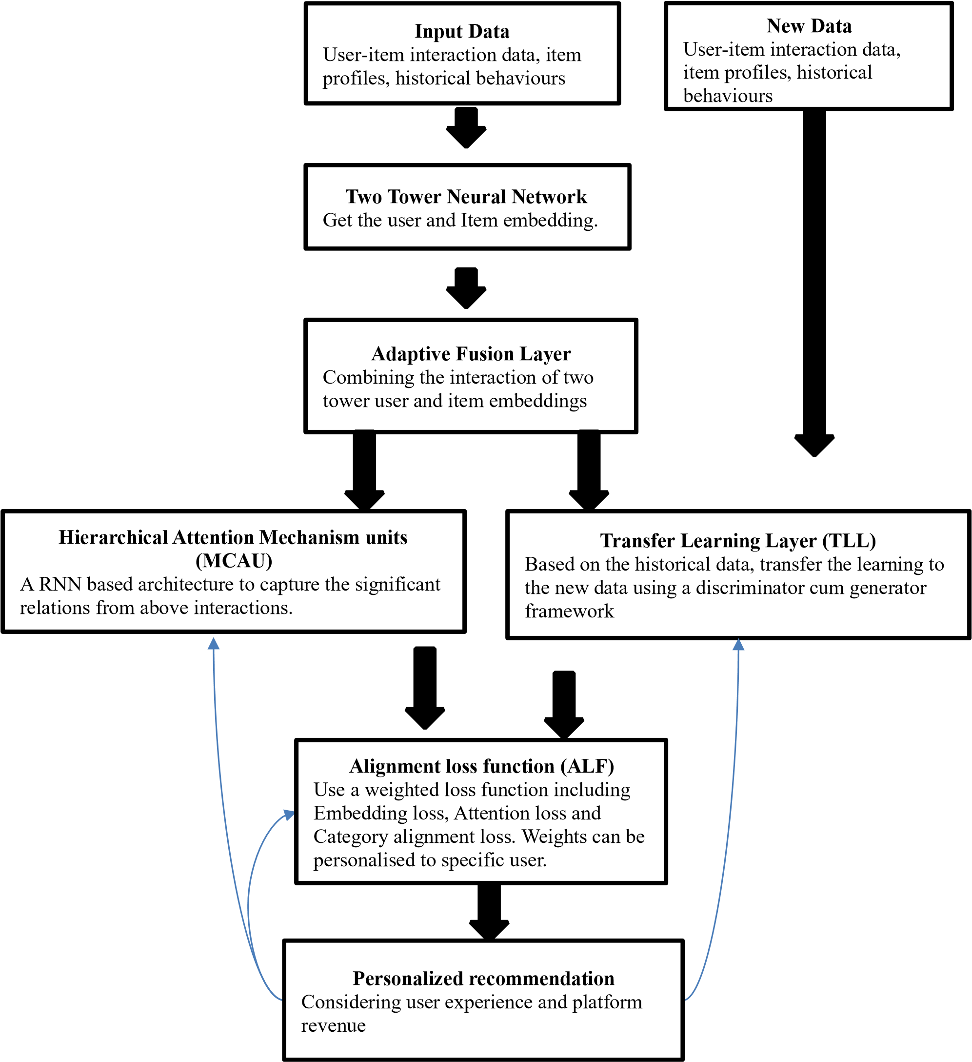
Methodology Adopted
Retrieval Independent Model
AFETLER Framework Overview
Addressing personalized recommendation challenges in e-commerce.
Focus on user diversity, effective information utilization, cold-start issues, and category alignment.
Filtering cum Ranking Layer Independent Model
6

Slide 9
Methodology Adopted
Two-Tower Neural Network (TNN)
Input: User features ('u') and item features, historical interactions ('i').
Process: Query Tower processes user features ('u') via 'NNquery', Item Tower processes item features ('i') via 'NNitem'.
Outcome: User ('𝑒#') and item ('𝑒$') embeddings capturing distinct characteristics.
Adaptive Fusion
Input: User embeddings ('𝑒#') and item embeddings ('𝑒$').
Process: Augmented user vectors ('augmented') and augmented item vectors ('augmented') formed by blending user and item embeddings.
Outcome: Enhanced representations of users and items for more comprehensive interactions.
7

Slide 10
Methodology Adopted
Hierarchical Attention Mechanism (MCAU)
Input: Augmented user vectors ('𝑎𝑢𝑔𝑢𝑚𝑒𝑛𝑡𝑒𝑑 𝑢') and augmented item vectors ('𝑎𝑢𝑔𝑢𝑚𝑒𝑛𝑡𝑒𝑑 𝑖').
Process: Hierarchical Attention applied to user-level and item-level interactions, emphasizing significant aspects of data.
Outcome: Augmented vectors enriched with contextually relevant information.
Transfer Learning for New Arrivals
Input: Item profiles of new items and historical interactions.
Process: Generator enhances embeddings for new items ('𝑒$𝑛𝑒𝑤') using historical item embeddings ('𝑒$'). Discriminator assesses the quality of enhanced embeddings.
Outcome: Overcoming cold-start problem for new items, leading to improved recommendations.
8

Slide 11
Methodology Adopted
Alignment Loss Functions (ATL)
Components:
Embedding Loss: Measures the difference between predicted and actual interactions.
Attention Loss: Ensures relevant information capture.
Category Alignment Loss: Addresses category-based item alignment.
Optimization: Combination of loss functions optimized through backpropagation.
Outcome: Model refinement for accurate user-item interactions and category alignments.
Feedback Loop for Continuous Improvement
Mechanism: Combines rewards and penalties based on user interactions and desired outcomes.
Function: Adjusts recommendations iteratively to improve user engagement, satisfaction, and platform revenue.
9

Slide 12
Results Obtained
Dataset an evaluation criteria
Dataset:
The Movie Lens 100k dataset contains user ratings for movies. It consists of approximately 100,000 ratings ranging from 1 to 5, given by users to different movies. The dataset includes user information, movie information, and corresponding ratings. This dataset serves as the foundation for our experimental evaluation.
User Information: User demographics such as age, gender, occupation.
Movie Information: Movie attributes including genres, release year.
Ratings: User ratings for various movies
Evaluation:
Mean Absolute Error (MAE)
Mean Squared Error (MSE)
Accuracy (Top K=10 recco)
Precision (@ K=10
ROC-AUC (@ K=10)
10

Slide 13
Results Obtained
Model | MSE (@k=10) | MAE (@k=10) | Accuracy (@k=10) | Precision (@k=10) | ROC-AUC (@ k=10)
Matrix Factorization | 1.58 | 1.02 | 0.42 | 0.60 | 0.64
Deep FM | 1.05 | 0.32 | 0.48 | 0.66 | 0.68
Two Tower Base Model | 1.18 | 0.35 | 0.07 | 0.12 | 0.24
AFETLER Base Model | 1.10 | 0.28 | 0.53 | 0.68 | 0.68
11

Slide 14
Results Obtained
Results
1.8
1.6
1.4
1.2
1
0.8
0.6
0.4
0.2
0
MSE
MAE
Accuracy (@
Precision (@
ROC-AUC (@
k=10)
k=10)
k=10)
Matrix Factorization
Deep FM
Two Tower Base Model
AFETLER Base Model
12

Slide 15
Conclusion & Future Work
Conclusion:
AFETLER Advancements: AFETLER improves user shopping experiences by delivering personalized and relevant recommendations. Its key innovations include dynamic fusion, cold-start mitigation via transfer learning, and efficient user-item interaction capture with hierarchical attention methods.
Performance: AFETLER outperformed existing models with lower MSE, MAE, higher accuracy, precision, and ROC-AUC values, especially in top-10 recommendations, highlighting its predictive accuracy and user interaction classification capabilities.
Impact: Bridging the gap between precise suggestions and increased platform revenue, AFETLER enhances user experiences and boosts financial outcomes for e-commerce platforms.
Future Research Directions:
Real-World Data Validation: Validate AFETLER's efficacy in dynamic e-commerce contexts by experimenting with real-world data from diverse sources, including user-generated content and contextual data.
Enhancements: Improve transfer learning processes, dynamic hyperparameter tuning, and transition to online learning and deployment strategies for a more adaptable system.
Comprehensive Recommendations: Focus on interpretability, effective user feedback incorporation, suggestion diversity, scalability optimization, and efficient comparative analyses against existing models for a holistic recommendation system landscape.
Conceptual Framework: View the developed AFETLER model as a conceptual foundation, encouraging further research and development to create a comprehensive and functional recommendation system based on the AFETLER approach.
13

Slide 16
References
[1] Markellou, P, Mousourouli, I., Sirmakessis, S, & Tsakalidis, A. (n.d.). Personalized E-commerce Recommendations.
[2] Ko, H, Lee, S, Park, Y, & Choi, A. (2022). A Survey of Recommendation Systems: Recommendation Models, Techniques, and Application Fields. Electronics, 11(1), 141. https://doi.org/10.3390/electronics11010141
[3] Jamali, M., & Ester, M. (2010). A Matrix Factorization Technique with Trust Propagation for Recommendation in Social Networks.
[4] Koren, Y. (2010). Collaborative filtering with temporal dynamics. Communications of the ACM, 53(4), 89–97. https://doi.org/10.1145/1721654.1721677
[4] Koren, Y. (n.d.). Factorization Meets the Neighbourhood: a Multifaceted Collaborative Filtering Model.
[5] Bobadilla, J., Alonso, S., & Hernando, A. (2020). Deep Learning Architecture for Collaborative Filtering Recommender Systems. Applied Sciences, 10(7), 2441. https://doi.org/10.3390/app10072441
[6] Covington, P., Adams, J., & Sargin, E. (2016). Deep Neural Networks for YouTube Recommendations. Proceedings of the 10th ACM Conference on Recommender Systems. https://doi.org/10.1145/2959100.2959190
[7] Zhou, G, Mou, N, Fan, Y, Pi, Q, Bian, W, Zhou, C., Zhu, X., & Gai, K. (2019). Deep Interest Evolution Network for Click-Through Rate Prediction. Proceedings of the AAAI Conference on Artificial Intelligence, 33(01), 5941–5948. https://doi.org/10.1609/aaai.v33i01.33015941
[8] Feng, P. J., Pan, P., Zhou, T., Chen, H., & Luo, C. (2021). Zero Shot on the Cold-Start Problem. Proceedings of the 30th ACM International Conference on Information & Knowledge Management. https://doi.org/10.1145/3459637.3482312
[9] Zou, H., Gong, Z., Zhang, N., Zhao, W., & Guo, J. (2013). Trust Rank: A Cold-Start tolerant recommender system. Enterprise Information Systems, 9(2), 117–138. https://doi.org/10.1080/17517575.2013.804587
[10] Xin, S., Li, Z., Zou, P., Long, C., Zhang, J., Bu, J., & Zhou, J. (2021, April 1). ATNN: Adversarial Two-Tower Neural Network for New Item’s Popularity Prediction in E-commerce. IEEE Xplore. https://doi.org/10.1109/ICDE51399.2021.00282
[11] Wang, J., Zhu, J., & He, X. (2021). Cross-Batch Negative Sampling for Training Two-Tower Recommenders. ArXiv (Cornell University). https://doi.org/10.1145/3404835.3463032
[12] Yu, Y., Wang, W., Feng, Z., & Xue, D. (n.d.). A Dual Augmented Two-tower Model for Online Large-scale Recommendation. https://doi.org/10.1145/1122445.1122456
14

Slide 17
Thanks for your attention

